Slide 1
Announcements
Homework 2: CSPs
Due Monday 9/12 at 11:59 pm.
Have an emergency of some kind, contact Sherdil. Due to EdX limitations, exceptions granted for deadlines in only rare cases. Invalid exceptions: Dead computer, dead internet, etc.
Project 1: Search
Has been released! Due Friday 9/16 at 5pm.
Start early and ask questions. It’s longer than most! There are extra credit “reach” objectives that are tough to beat.
Solo or in group of two.
Contest 1: Search
Released today! Due Sunday 9/18 at 11:59pm.
Solo or in group of two.
Friendly competition. Consider joining in, even if you’re not the competitive type.
Extra credit opportunities if you beat the staff bots. Even more extra credit for top place finishers.

Slide 2
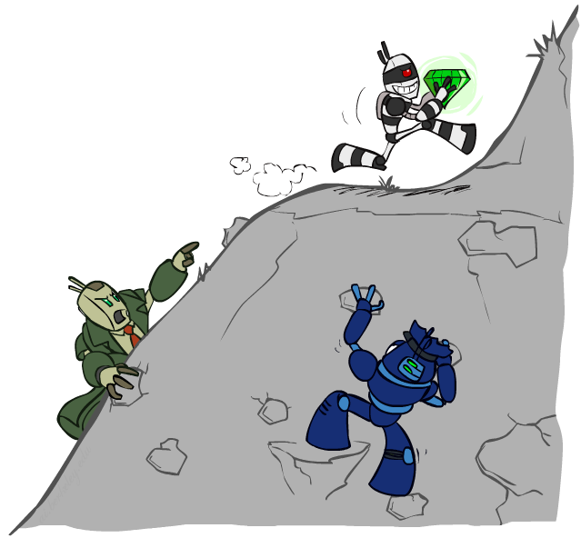
CS 188: Artificial Intelligence
Constraint Satisfaction Problems II
Instructors: Adam Janin and Josh Hug
University of California, Berkeley
[These slides were created by Dan Klein, Pieter Abbeel, and Josh Hug for CS188 Intro to AI at UC Berkeley. All CS188 materials available at http://ai.berkeley.edu.]
Notes:
Please retain proper attribution, including the reference to ai.berkeley.edu. Thanks!

Slide 3

Today
Efficient Solution of CSPs
A few more improvements to CSP-Backtracking.
An alternate approach: Iterative Improvement.
Local Search

Slide 4


Reminder: CSPs
CSPs:
Variables
Domains
Constraints
Implicit (provide code to compute)
Explicit (provide a list of the legal tuples)
Unary / Binary / N-ary
Goals:
Here: find any solution
Also: find all, find best, etc.

Slide 5
Backtracking Search

Slide 6


Improving CSP-Backtracking
General-purpose ideas give huge gains in speed
Ordering: Can we pick better orderings?
Yes! Can use most constrained variable (MCV) and least constraining value (LCV).
Filtering: Can we detect inevitable failure early?
Yes! Use forward checking or arc consistency (e.g. AC-3).
AC-3 more expensive, but catches problems earlier.
Will discuss new idea of “K-consistency” briefly today.
Structure: Can we exploit the problem structure?
Note: Overall problem is still NP-hard.
✓
14
?
✓
10 11
12 13
?
6 7 8 9
?
1 2 3 4 5

Slide 7

Arc Consistency and Beyond
An arc X → Y is consistent iff for every x in the tail there is some y in the head which could be assigned without violating a constraint

Slide 8
Arc Consistency Practice/Review
Variables: X, Y, Z
Domains: {1, 2, 3, 4, 5, 6, 7, 8, 9, 10, 11, 12, 13, 14, 15, 16}
Constraints:
X is either the square or the square root of Y.
Y is either the square or the square root of Z.
X is less than or equal to Z.
Some sample solutions:
X, Y, Z = {1, 1, 1}
X, Y, Z = {2, 4, 16}
X, y, Z = {9, 3, 9}
Problem 1: If we run AC-3 on this constraint graph, what are the possible values for X, Y, Z?
Problem 2: If we run AC-3, then assign X = 16, then run arc-consistency again, what are the possible values for Y and Z?
<=
X
Z
sq
Y
sq

Slide 9

Arc Consistency Practice
Variables: X, Y, Z
Domains: {1, 2, 3, 4, 5, 6, 7, 8, 9, 10, 11, 12, 13, 14, 15, 16}
Problem 1: If we run AC-3 on this constraint graph, what are the possible values for X, Y, Z?
<=
{1, 2, 3, 4, 5, 6, 7, 8, 9, 10, 11, 12, 13, 14, 15, 16}
{1, 2, 3, 4, 5, 6, 7, 8, 9, 10, 11, 12, 13, 14, 15, 16}
sq
{1, 2, 3, 4, 5, 6, 7, 8, 9, 10, 11, 12, 13, 14, 15, 16}
sq

Slide 10
Arc Consistency Practice
Variables: X, Y, Z
Domains: {1, 2, 3, 4, 5, 6, 7, 8, 9, 10, 11, 12, 13, 14, 15, 16}
Problem 2: If we run AC-3, assign X = 16 and run AC-3 again, what are the possible values for Y and Z?
<=
16
{1, 2, 3, 4, 9, 16}
sq
{1, 2, 3, 4, 9, 16}
sq
Reminder: If you delete from a node, must re-enqueue all arcs pointing at that node!

Slide 11
Limitations of Arc Consistency
After enforcing arc consistency:
Can have one solution left
Can have multiple solutions left
Can have no solutions left (and not know it)
Arc consistency still runs inside a backtracking search!
Consistent, 2 solutions.
Consistent, no solutions!
What went wrong here?

Slide 12
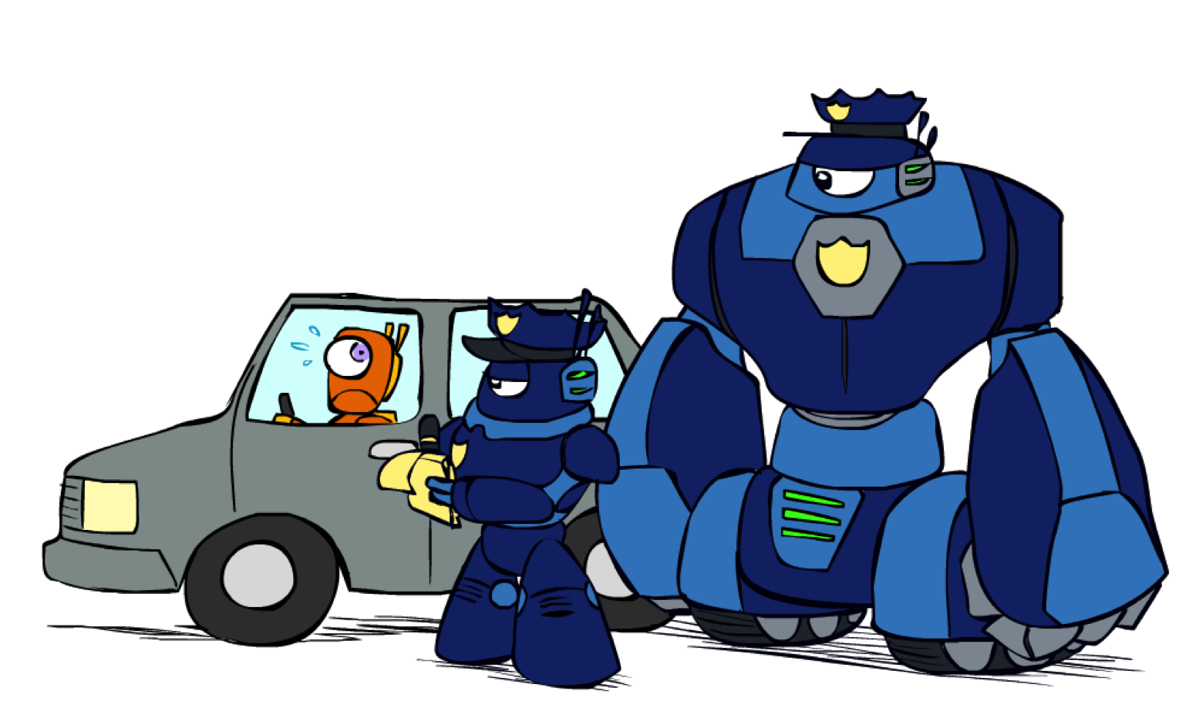
K-Consistency

Slide 13
K-Consistency
Increasing degrees of consistency
1-Consistency (Node Consistency): Each single node’s domain has a value which meets that node’s unary constraints
2-Consistency (Arc Consistency): For each pair of nodes, any consistent assignment to one can be extended to the other
K-Consistency: For each k nodes, any consistent assignment to k-1 can be extended to the k^{th} node
Higher k more expensive to compute
(You need to know the k=2 case: arc consistency)
k=1
k=2
k=4
This graph is 2-consistent, but not 3-consistent.

Slide 14
Strong K-Consistency
Strong k-consistency: also k-1, k-2, … 1 consistent
Claim: strong n-consistency means we can solve without backtracking!
Why?
Choose any assignment to any variable
Choose a new variable
By 2-consistency, there is a choice consistent with the first
Choose a new variable
By 3-consistency, there is a choice consistent with the first 2
…
Lots of middle ground between arc consistency (a.k.a. 2-consistency) and n-consistency!
Example, k = 3 (path consistency) helps avoid situations like that to the right.
Won’t discuss algorithms for k > 2. If you’re curious see this link.

Slide 15
Improving CSP-Backtracking
General-purpose ideas give huge gains in speed
Ordering: Can we pick better orderings?
Yes! Can use most constrained variable (MCV) and least constraining value (LCV).
Filtering: Can we detect inevitable failure early?
Yes! Use forward checking, arc consistency, or K-consistency.
K-consistency > arc consistency > forward checking in both cost and quality of filtering (assuming k > 2).
Structure: Can we exploit the problem structure?
Note: Overall problem is still NP-hard.
✓
14
✓
10 11
12 13
6 7 8 9
?
1 2 3 4 5

Slide 16
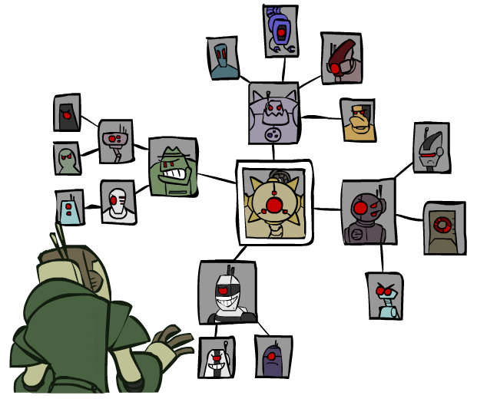
Structure

Slide 17
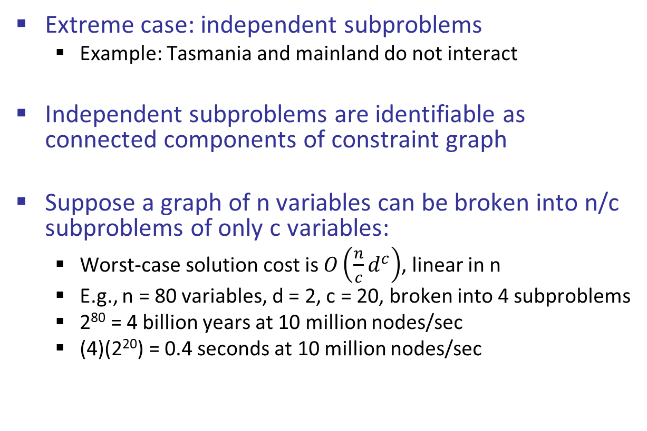
Problem Structure
Extreme case: independent subproblems
Example: Tasmania and mainland do not interact
Independent subproblems are identifiable as connected components of constraint graph
Suppose a graph of n variables can be broken into n/c subproblems of only c variables:
Worst-case solution cost is $O\left(\frac{n}{c}d^{c}\right)$, linear in n
E.g., n = 80 variables, d = 2, c = 20, broken into 4 subproblems
2⁸⁰ = 4 billion years at 10 million nodes/sec
(4)(2²⁰) = 0.4 seconds at 10 million nodes/sec

Slide 18
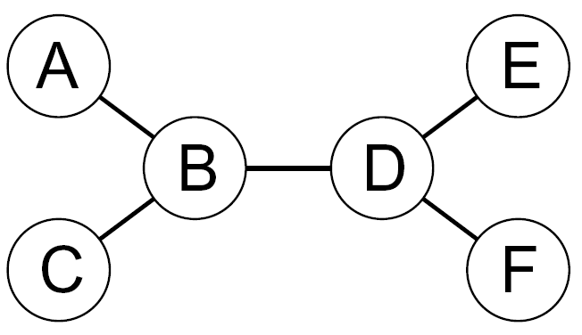
Tree-Structured CSPs
Theorem: if the constraint graph has no loops, the CSP can be solved in O(n d²) time
Compare to general CSPs, where worst-case time is O(d^{n})
This property also applies to probabilistic reasoning (later): an example of the relation between syntactic restrictions and the complexity of reasoning

Slide 19
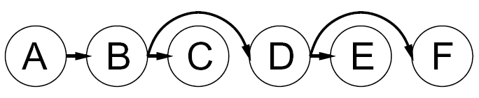
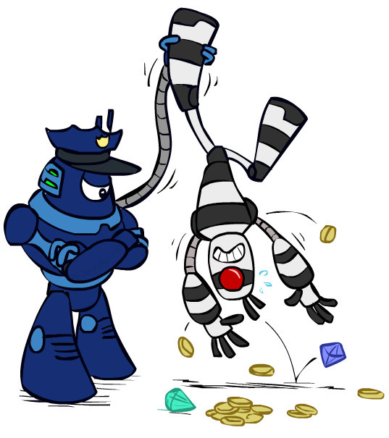

Tree-Structured CSPs
Algorithm for tree-structured CSPs:
Order: Choose a root variable, order variables so that parents precede children
Remove backward: For i = n : 2, apply RemoveInconsistent(Parent(X_{i}),X_{i})
Assign forward: For i = 1 : n, assign X_{i} consistently with Parent(X_{i})
Runtime: O(n d²) (why?)

Slide 20
Tree-Structured CSPs (Tricky Slide. Revisit Later!)
Claim 1: After backward pass, all parent-to-child arcs are 2-consistent
Proof: Each X→Y was made 2-consistent at one point and Y’s domain could not have been reduced thereafter (because Y’s children were processed before Y)
Claim 2: If parent-to-child arcs are consistent, forward assignment will not backtrack
Proof: Induction on position, e.g. A->B 2-consistent means any choice for A is safe for B.
Why doesn’t this algorithm work with cycles in the constraint graph?
Arc-consistency doesn’t guarantee safety for multiple parents! Induction on position fails.
Note: we’ll see this basic idea again with Bayes’ nets

Slide 21
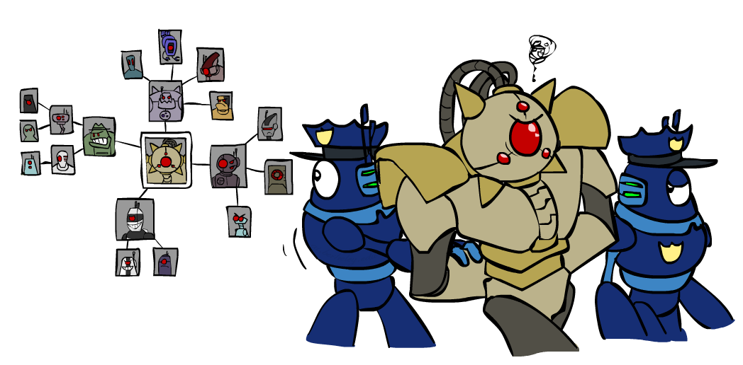
Improving Structure

Slide 22
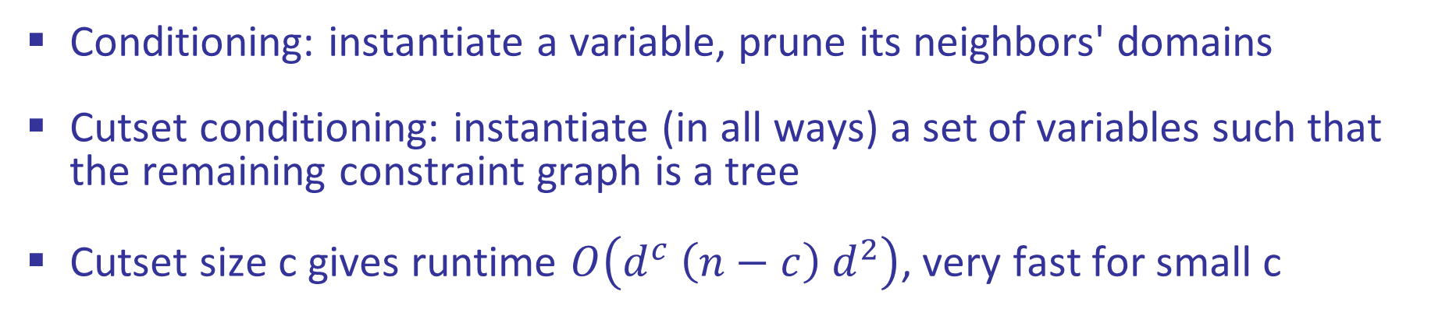
Nearly Tree-Structured CSPs
Conditioning: instantiate a variable, prune its neighbors' domains
Cutset conditioning: instantiate (in all ways) a set of variables such that the remaining constraint graph is a tree
Cutset size c gives runtime $O\left(d^{c} \left(n−c\right){ d}^{2}\right)$, very fast for small c

Slide 23
Cutset Conditioning
Choose a cutset
SA
Instantiate the cutset (all possible ways)
SA
SA
SA
Compute residual CSP for each assignment
Solve the residual CSPs (tree structured)

Slide 24
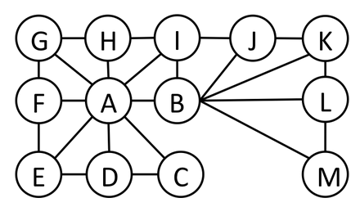
Finding the Minimum Cutset
Find the smallest cutset for the graph below.
Set of nodes which, when removed, results in a tree.

Slide 25
Tree Decomposition*
Idea: create a tree-structured graph of mega-variables
Each mega-variable encodes part of the original CSP
Subproblems overlap to ensure consistent solutions
M1
M2
M3
M4
WA
≠
NT
NT
≠
Q
Q
≠
NSW
NSW
≠
V
≠
≠
≠
≠
≠
≠
≠
≠
SA
SA
SA
SA
Agree on shared vars
Agree on shared vars
Agree on shared vars
{(WA=r,SA=g,NT=b),
(WA=b,SA=r,NT=g),
…}
{(NT=r,SA=g,Q=b),
(NT=b,SA=g,Q=r),
…}
Agree: (M1,M2) ∈
{((WA=g,SA=g,NT=g), (NT=g,SA=g,Q=g)), …}

Slide 26
Improving CSP-Backtracking
General-purpose ideas give huge gains in speed
Ordering: Can we pick better orderings?
Yes! Can use most constrained variable (MCV) and least constraining value (LCV)
Filtering: Can we detect inevitable failure early?
Yes! Use forward checking, arc consistency, or K-consistency
K-consistency > arc consistency > forward checking in both cost and quality of filtering
Structure: Can we exploit the problem structure?
Tree CSPs: Use tree-algorithm
Almost tree CSPs: Use cutset conditioning
Wanna get fancy? Try Tree Decomposition
✓
14
✓
10 11
12 13
6 7 8 9
✓
1 2 3 4 5

Slide 27
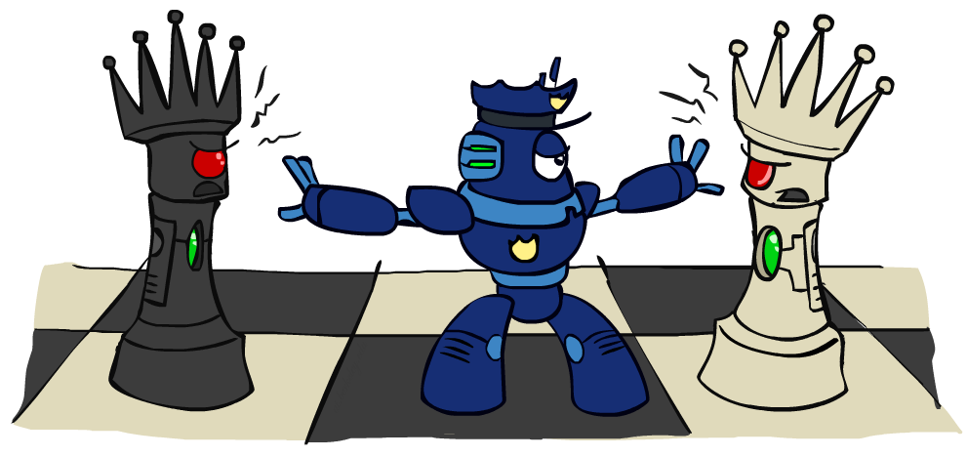
Alternate Approach: Iterative Improvement
CSP-Backtracking works, but there are other approaches. Iterative Improvement is one such approach.

Slide 28
Iterative Algorithms for CSPs
Local search methods typically work with “complete” states, i.e., all variables assigned
To apply to CSPs:
Take an assignment with unsatisfied constraints
Operators reassign variable values
No fringe! Live on the edge.
Algorithm: While not solved,
Variable selection: randomly select any conflicted variable
Value selection: min-conflicts heuristic:
Choose a value that violates the fewest constraints
i.e., hill climb with h(n) = total number of violated constraints
i.e., don’t change values if all the other possibilities are actually worse

Slide 29
Example: 4-Queens
States: 4 queens in 4 columns (4⁴ = 256 states)
Operators: move queen in column
Goal test: no attacks
Evaluation: c(n) = number of attacks
[Demo: n-queens – iterative improvement (L5D1)]
[Demo: coloring – iterative improvement]
Notes:
L5D1 – python demos
Coloring – javascript demos

Slide 30

Video of Demo Iterative Improvement – n Queens

Slide 31
Video of Demo Iterative Improvement – Coloring

Slide 32
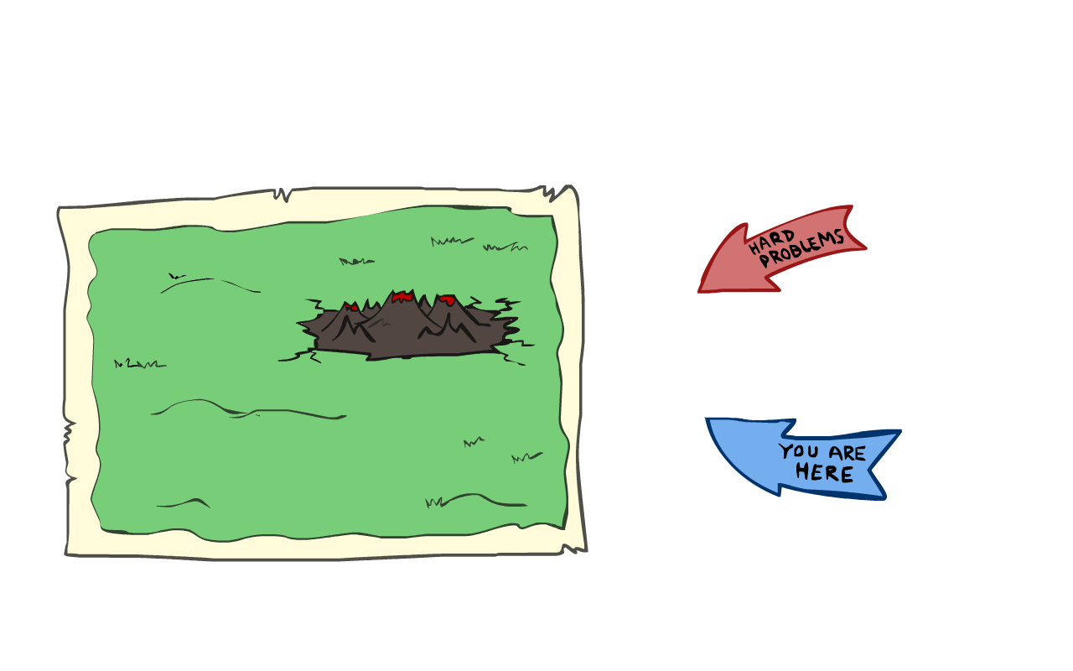
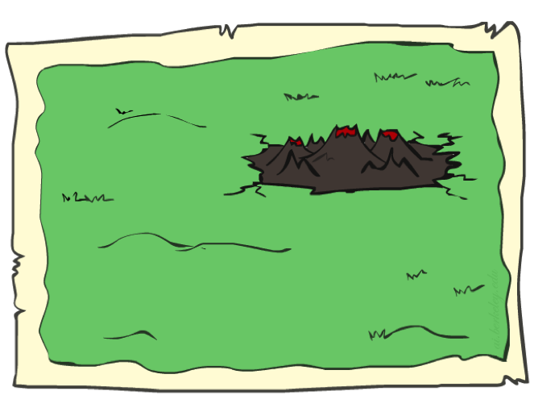
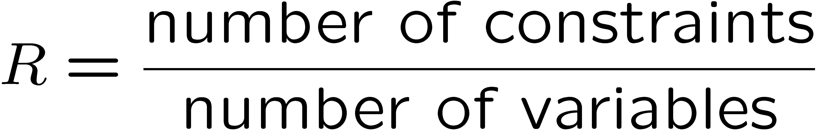
Performance of Min-Conflicts
Given random initial state, can solve n-queens in almost constant time for arbitrary n with high probability (e.g., n = 10,000,000)!
The same appears to be true for any randomly-generated CSP except in a narrow range of the ratio
Figure via Stuart Russell

Slide 33
Completeness of Min-Conflicts [???]
Completeness
Design a CSP for which Min-Conflicts is not guaranteed to be complete, i.e. might miss a solution that exists.
Hint: Design a situation where we must partially undo a partial solution to arrive at a complete solution.

Slide 34

Completeness of Min-Conflicts [???]
Min-Conflicts and 5-Queens
For the 5-Queens board shown:
How many conflicts are there?
What is the best move that Min-Conflicts can make (in terms of # of conflicts)?
Recall: Can only move a single queen within a single row.
How many conflicts remain after taking the best move?

Slide 35
Min-Conflicts, 5-Queens, Sideways Moves
For the 5-Queens board shown:
How many conflicts are there?
2
What is the best move that Min-Conflicts can make (in terms of # of conflicts)?
There are many possibilities, e.g. moving Queen 2 to Column 2.
How many conflicts remain after taking the best move?
2
A move that does not improve things is known as a “sideways” move.
This is in contrast to an “uphill” move.

Slide 36
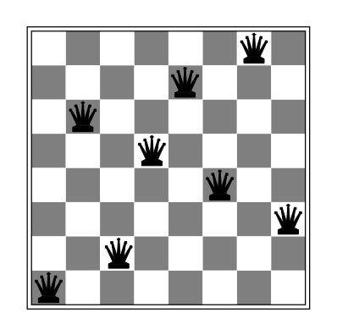
Min-Conflicts and Completeness
Completeness: Will Min-Conflicts always find a solution if one exists?
For N-Queens: Yes, will eventually get there if we allow sideways moves (cite?)
For other problems: No. (cite?)

Slide 37
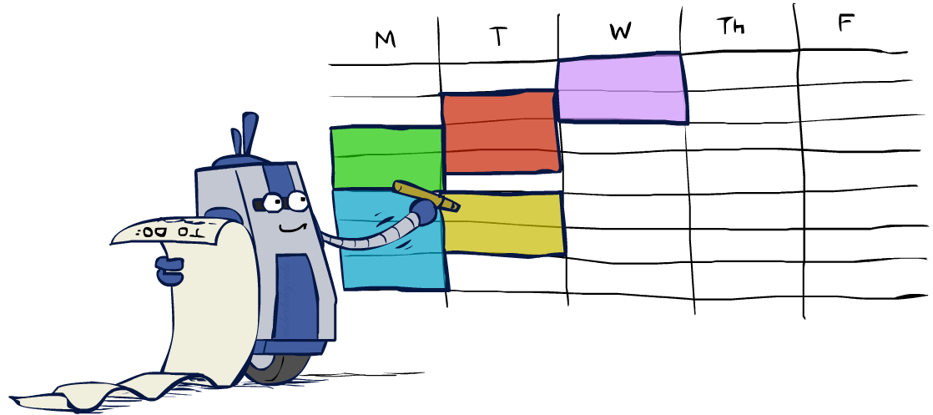
Summary: CSPs
CSPs are a special kind of search problem:
States are partial assignments
Goal test defined by constraints
Basic solution: CSP-backtracking search
Speed-ups:
Ordering
Filtering
Structure
Alternate solution: Iterative Min-conflicts. Often effective in practice, particularly for huge problems.

Slide 38
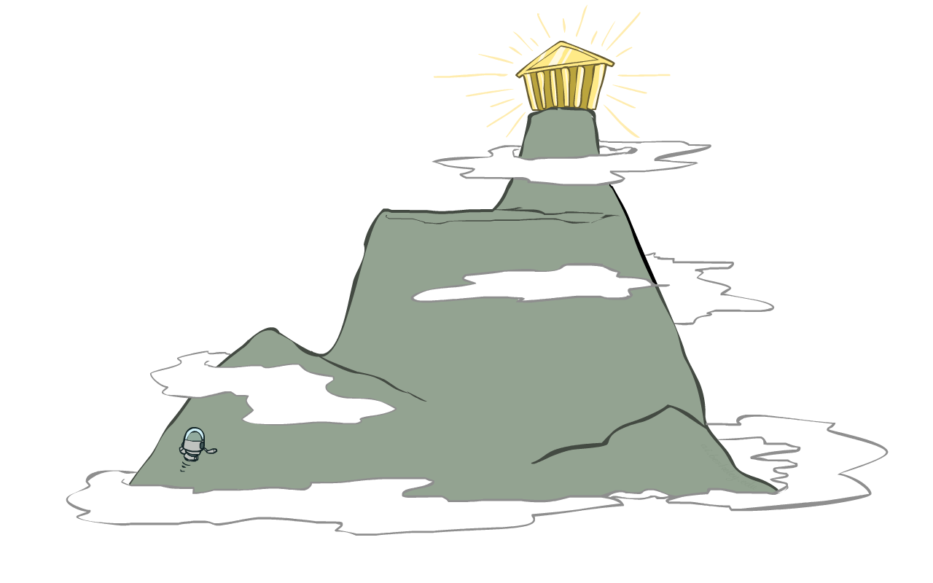
Local Search

Slide 39
Local Search
Tree search keeps unexplored alternatives on the fringe (ensures completeness)
Examples: DFS, BFS, UCS, A*, CSP-Backtracking.
Local search: improve a single option until you can’t make it better (no fringe!)
Example: Min-Conflicts
New successor function: local changes
Generally much faster and more memory efficient (but incomplete and suboptimal)

Slide 40
Hill Climbing
Simple, general idea:
Start wherever
Repeat: move to the best neighboring state
If no neighbors better than current, quit
What’s bad about this approach?
Complete?
Optimal?
What’s good about it?

Slide 41
Hill Climbing Diagram
shoulder

Slide 42
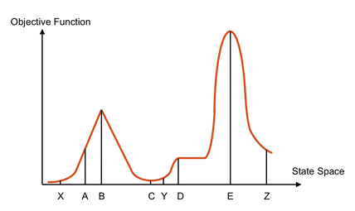
Completeness of Min-Conflicts [???]
Hill-Climbing Quiz
Starting from X, where do you end up ?
Starting from Y, where do you end up ?
Starting from Z, where do you end up ?

Slide 43

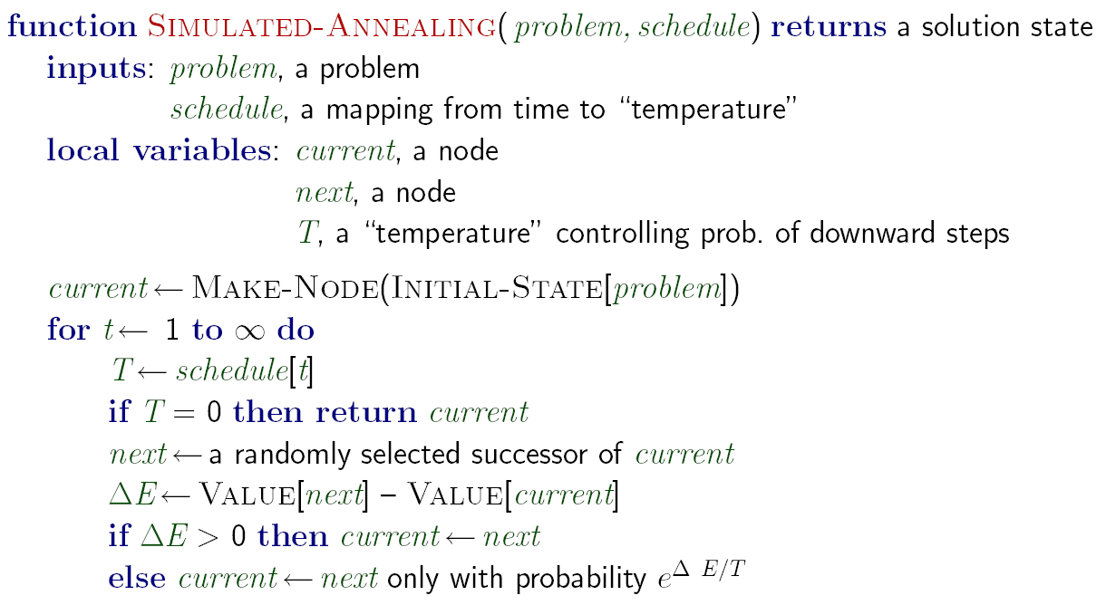
Simulated Annealing
Idea: Escape local maxima by allowing downhill moves (demo)
But make them rarer as time goes on

Slide 44
Simulated Annealing
Theoretical guarantee:
If T decreased slowly enough, will converge to optimal state!
Is this an interesting guarantee?
Kinda. Have to run algorithm forever to get guaranteed optimum.
Sounds like magic, but reality is reality:
The more downhill steps you need to escape a local optimum, the less likely you are to ever make them all in a row
People think hard about ridge operators which let you jump around the space in better ways

Slide 45
Random Restarts
Vanilla hill climbing and simulated annealing can be parallelized:
After running for a while, restart from a new random starting point.
Restart conditions include:
After running for Z total steps.
After spending Z units of time on a shoulder.
Anything else you can dream.
Can run many random searches in parallel.
24
23
20
11
25
22
20
11
25
23
21
11
27
26
20
2
…
…
…
…
24748552
24748652
24748652
24748653
32752411
32752421
32752621
42752621
24415124
34415124
34415125
34415126
32543213
32743213
32343213
99123123
Number of constraints obeyed
4th search performs random restart.

Slide 46
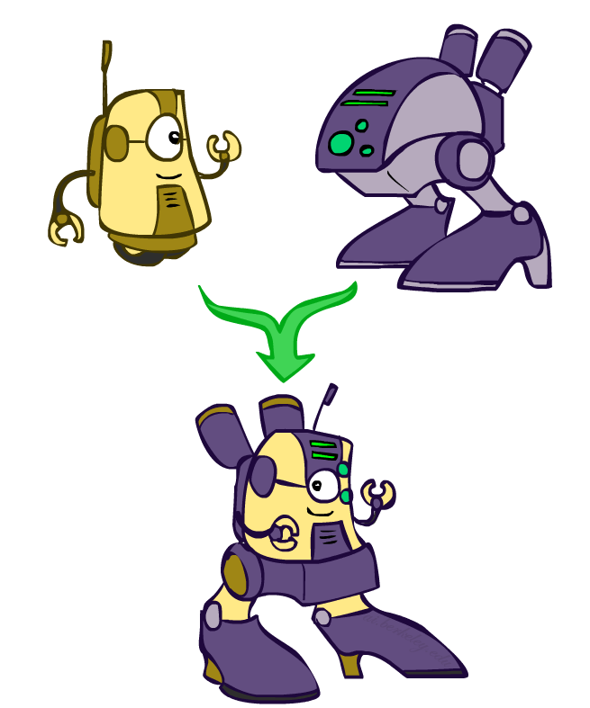
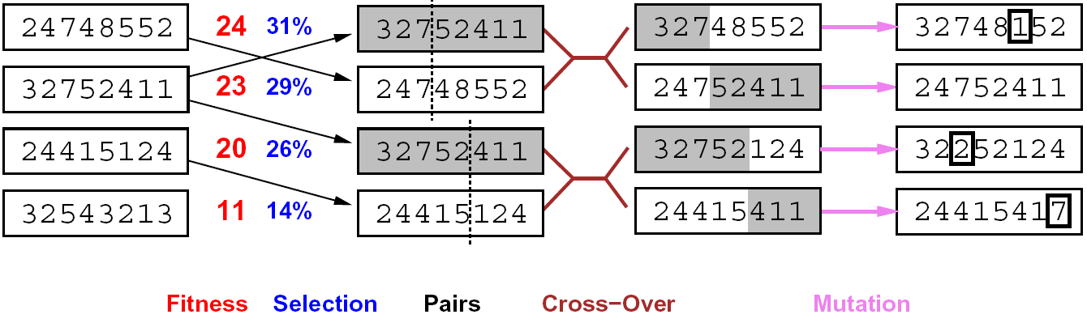
Genetic Algorithms
Genetic algorithms use a natural selection metaphor
Keep best N hypotheses at each step (selection) based on a fitness function
Also have pairwise crossover operators, with optional mutation to give variety
Instead of taking a step in your landscape, take a huge random leap
Possibly the most misunderstood, misapplied (and even maligned) technique around

Slide 47
Example: N-Queens
Why does crossover make sense here?
When wouldn’t it make sense?
What would mutation be?
What would a good fitness function be?

Slide 48

Next Time: Adversarial Search!
Example: Picking a move in chess by considering potential opponent’s moves.

Slide 49
Example: Fault Diagnosis
Causes
Symptoms
Fault networks:
Variables?
Domains?
Constraints?
Various ways to query,
given symptoms
Some cause (abduction)
Simplest cause
All possible causes
What test is most useful?
Prediction: cause to effect
We’ll see this idea again with Bayes’ nets
SMTP down
Can’t email
DNS down
Can’t IM
Firewall blocking
Can’t print
Printer jam

Slide 50
Beam Search
Like greedy hillclimbing search, but keep K states at all times:
Variables: beam size, encourage diversity?
The best choice in MANY practical settings
Complete? Optimal?
Why do we still need optimal methods?
Greedy Search
Beam Search

